Slide 1

Anonymous chat
By: Rustem Myrsagaliev, Alikhan Zhusipnazar

Slide 2


"Anonymous Chat" is a social network with functions of keeping confidential information.
Where you are being anonymous you can communicate with the same anonymous people without losing your confidential information.

Slide 3

The goal about our project
Anonymus chat
The goal of our project: enable people to communicate with random people while remaining completely anonymous.

Slide 4
The advantages of our site:
It is in our nature that we are less restrained when talking to strangers or when writing text messages than when talking to someone face-to-face online, we feel more confident, less withdrawn and able to express ourselves better, not shy and not afraid of condemnation.
So, first is the opportunity to express everything that worries you without fear of being judged
Confidentiality
Allows people to make friends
Talk freely about their problems
You can also test a new type of online dating, while feeling complete security and absolute anonymity.
Also, talking anonymously with someone can be a great substitute for psychotherapy.

Slide 5

The problem
The problem
For the shy people;
For people with the social phobia;
For people who want to keep their anonymus;

Slide 6




Features of our project
Features of our project
Gamer
Lofi
Retro

Slide 7

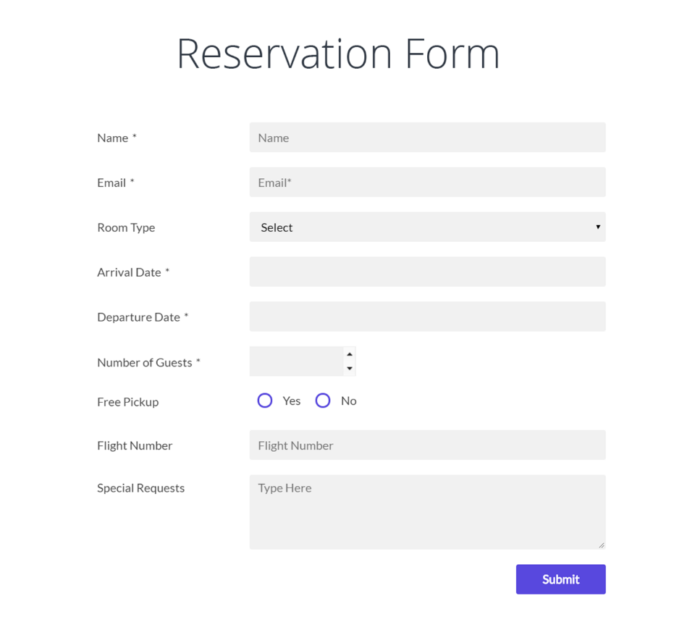
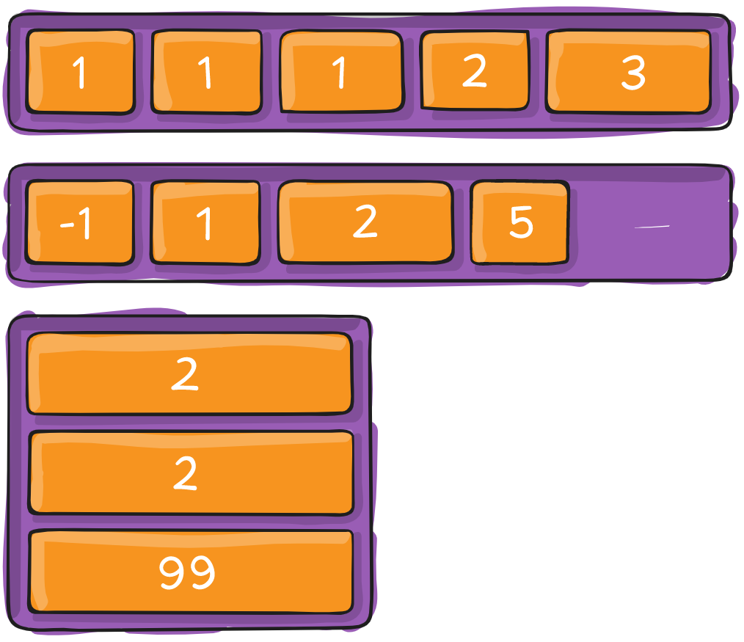
Instruments
Localstorage
Flexbox

Slide 8

Thanks for attention!

